Slide 1
Final Project Evaluation
Retrofitting Light-weight Language Models for Emotions using Supervised Contrastive Learning
Puneet Garg, 24M0757
Soumya Mukherjee, 24M0768
Pratik Man Shah, 24M0856
Date: 27/11/24

Slide 2
Problem Statement
Emotion detection in English sentences using embeddings from lightweight pre-trained language models (BERT and RoBERTa) after retrofitting them for emotions using supervised contrastive learning.
Input: English Sentence
Output: Primary Emotion that the sentence implies after passing it through the retrofitted emotion model.
Example:
Input: I love this.
Output: Love

Slide 3
Motivation
The motivation for choosing this problem statement — to refine pre-trained language models (PLMs) for better emotion recognition and encoding — is driven by several key factors:
Emotions Are Crucial in Human Communication
Complexity of Emotions in Text
Cross-Cultural and Linguistic Variability
Need for Emotion-Aware AI Systems
Scarcity of Emotion-Labeled Data

Slide 4
Literature Review
The paper we have referred is Retrofitting Light-weight Language Models for Emotions using Supervised Contrastive Learning (Sapan Shah, Sreedhar Reddy, and Pushpak Bhattacharyya. 2023 )
Emotion analysis in NLP focuses on detecting and understanding emotions expressed in text, a complex task that goes beyond basic sentiment analysis. Pre-trained language models (PLMs) like BERT and RoBERTa excel in general NLP tasks but lack emotion-awareness, which hinders their ability to capture emotional nuances.
The paper introduces Supervised Contrastive Learning (SCL) with Vector Space Preservation Loss to retrofit PLMs for emotions. This adjusts embeddings, improving emotion differentiation without losing general linguistic knowledge.
In summary, the paper builds emotion-aware retrofitting of PLMs to improve performance on emotion detection tasks, leveraging SCL and Vector Space Preservation (VSP) to enhance emotion recognition while maintaining the general language capabilities of PLMs

Slide 5
Dataset
The paper uses the go_emotions dataset, which is a publicly available large-scale dataset for emotion detection in text. It contains over 58,000 labeled Reddit comments annotated with 27 distinct emotion categories.
For training, we have only considered sentences with single emotion label.
Emotion Categories: Includes emotions like joy, sadness, anger, fear, surprise, and others, including neutral comments.
Annotation Type: Multi-label classification, where each comment can be assigned multiple emotion labels.
Size: Over 58,000 comments for training and testing.

Slide 6
Method/Technique
A BERT-based model was fine-tuned for emotion detection using the go_emotions dataset. The model leverages a Contrastive Learning approach, where the Supervised Contrastive Loss (SCL) is employed to refine the embeddings of a pre-trained BERT model to improve its ability to recognize emotions in text.
Tokenizer – BERT Tokenizer with maximum length of 128.
Architecture – The model uses a pre-trained BERT encoder to extract embeddings from input text and passes the embeddings through a projection head. The projection head maps the embeddings to a lower-dimensional space.
Loss - Integrates the Supervised Contrastive Loss and a Vector Space Preservation (VSP) loss
Clustering and Retrieval Evaluation: the model was evaluated using KMeans clustering (with 28 clusters) to group the embeddings. The Adjusted Mutual Information (AMI) and other clustering metrics (Adjusted Rand Index, Fowlkes-Mallows Score) were calculated to assess the quality of the clustering. The retrieval metrics used are Precision @ 1, Mean Average Precision @ K, Mean Reciprocal Rank.

Slide 7
Method/Technique(Contd.)
Experimental Details -
Model Training: The BERT model was fine-tuned using a learning rate of 5e-6 and AdamW optimizer. The model was trained for 20 epochs on a batch size of 64 using the cross-batch memory technique to enhance the effectiveness of Supervised Contrastive Loss.
Vector Space Preservation (VSP): In the implementation, the L1 norm was used with the VSP loss to preserve the original embeddings during the fine-tuning process.
Emotion Classifier Model Training: We extracted embeddings of all the training and test instances from the dataset using our emotion aware PLM. Then we trained a Feed Forward Neural Network on top of those embeddings for emotion classification.

Slide 8
Results
Model Name | AMI ↑ | ARI ↑ | FMS ↑ | MRR ↑ | P@1 ↑ | MAP@r ↑ | ∆emb ↓
BertEmo | 0.299 | 0.102 | 0.194 | 0.584 | 0.446 | 0.189 | 0.055
BertEmoElastic | 0.379 | 0.195 | 0.291 | 0.615 | 0.5 | 0.297 | 0.046
TLearnBERT | 0.378 | 0.133 | 0.229 | 0.625 | 0.503 | 0.28 | 0.941
RobertaEmo | 0.377 | 0.142 | 0.237 | 0.614 | 0.488 | 0.257 | 0.172
RobertaEmoElastic | 0.402 | 0.301 | 0.391 | 0.630 | 0.521 | 0.316 | 0.138
TLearnRoBERTa | 0.402 | 0.158 | 0.255 | 0.635 | 0.514 | 0.305 | 0.945

Slide 9
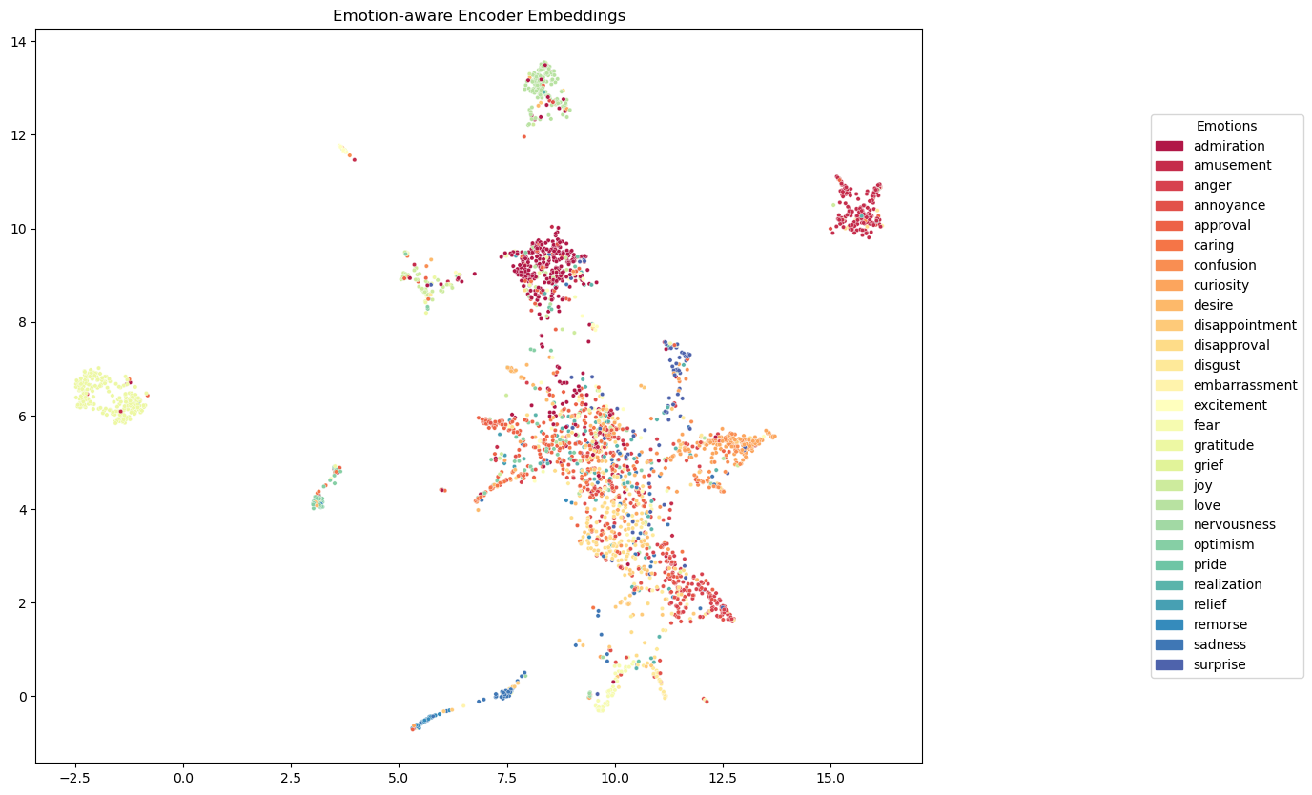
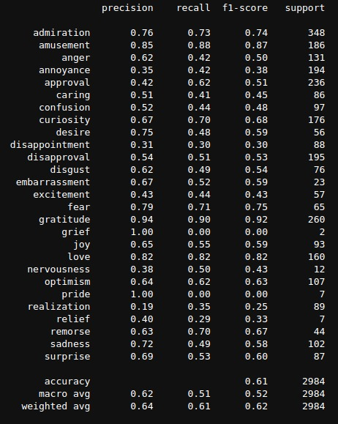
Analysis

Slide 10
Error analysis
In the next slide we have shown the normalized confusion matrix.
From the normalized confusion matrix, the top 5 misclassifications observed are:
Admiration confused with Approval
Anger confused with Annoyance
Annoyance confused with Anger
Annoyance confused with Disapproval
Approval confused with Realization.
Also Emotions like "grief," "remorse," and "embarrassment" have fewer instances. This imbalance affects the performance of our classification model.

Slide 11
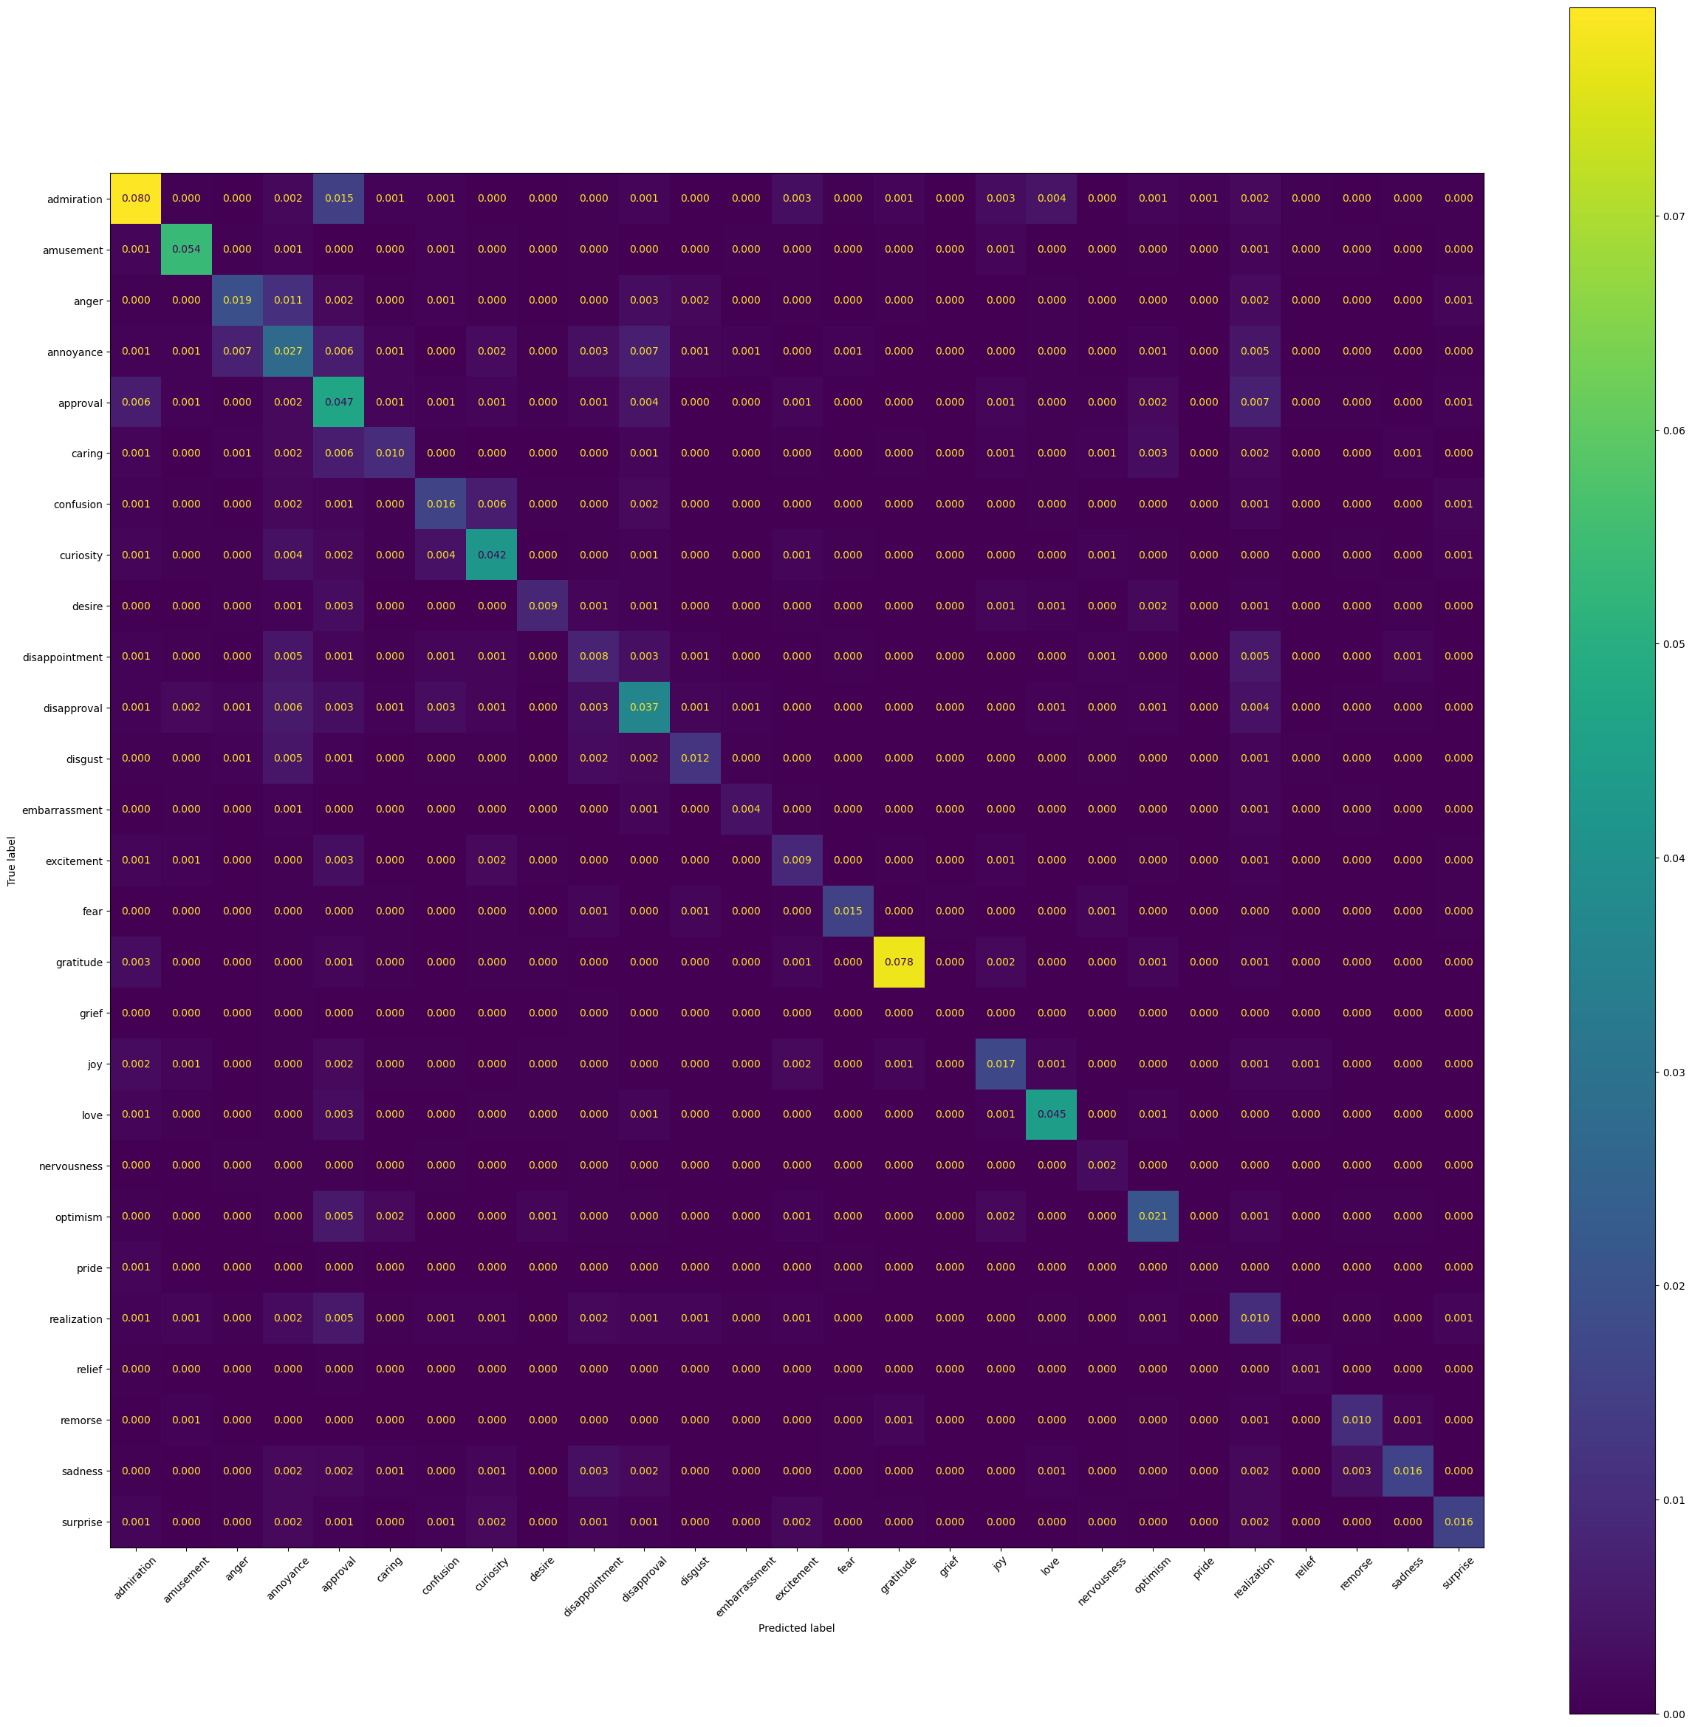

Slide 12
Improvements over the paper
We improved the paper's approach by using MSE Loss with L1 Loss to make the loss function robust to outliers for Vector Space Preservation (VSP).
Our Retrofitted model performed better on every clustering and retrieval metric than the base emo models while having less delta embeddings than the base emo models and our model is able to reach the same level of performance in clustering and retrieval metrics as compared to Tlearn based models which are mentioned as the best models in the paper in terms of emotion aspects.
Additionally, we created a Emotion Classifier from the embeddings of our custom Retrofitted Model to verify the emotion awareness of our model which we will show in the demo.

Slide 13
Learnings
Learnings from the Research Paper and Implementation
Emotion Recognition Complexity: Emotion detection involves capturing subtle and implicit nuances in text, which require fine-tuned models. The GoEmotions dataset with 27 emotion categories highlighted the challenge of distinguishing between overlapping emotion.
Effectiveness of Supervised Contrastive Loss (SCL): SCL improved the model’s ability to differentiate between emotions, especially in multi-label classification tasks. This was key to refining the embeddings and enabling more accurate emotion recognition.
Vector Space Preservation (VSP): The combination of MSE Loss and L1 Loss for VSP in our implementation led to better sparsity, preserving original embeddings while adapting to emotion recognition tasks. This helped reduce overfitting, especially on less frequent emotions.

Slide 14
Learnings(Contd.)
Evaluation Metrics: Improved results on metrics like AMI, ARI, and FMS demonstrated better clustering of emotion embeddings. Retrieval metrics such as MRR and P@1 showed higher accuracy in emotion-aware embedding retrieval.
UMAP Visualization: Visualizing embeddings after K-means Clustering with UMAP confirmed that our model better differentiated emotions in the embedding space, validating the effectiveness of retrofitting for emotion.
Data Bias and Representation: Despite efforts to balance emotions and filter harmful content, biases related to Reddit’s demographic and emotion labeling could still affect the model. This learning underscores the need for more diverse data to improve fairness and generalization

